Slide 1

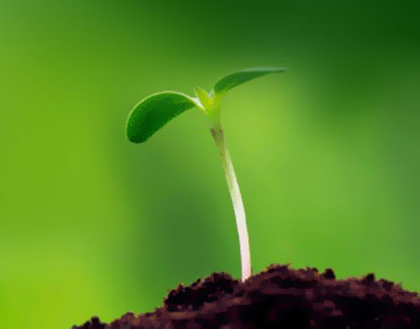
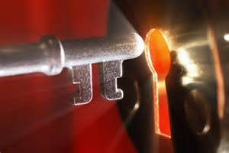
Six Secrets
of the
Christian Life

Slide 2
Introduction

Slide 3
Question ?
How does the Christian live the Christian life?

Slide 4
Secret #1
Christian Living is the Miracle
of Resurrection

Slide 5
The Problem
Believe
Eternal Life
Christ in you
New Life
Dead Body

Slide 6
The Solution
Believe
New Life
Dead Body
Righteousness
His Spirit
How?
Life

Slide 7
Secret #2
Christian Living is The Miracle
of Transformation

Slide 8

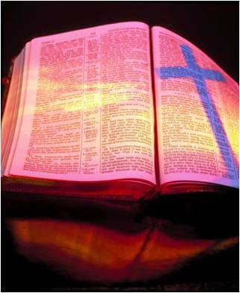
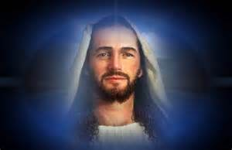
The Solution
Continuous Faith
Unveiled Face
Dead Body
His Power
Transformation
Process

Slide 9
The Solution
Continuous Faith
Unveiled Face
Life
His Power
Transformation
Process

Slide 10
Secret #3
Christian Living is coming to be in experience what we already are in our innermost being

Slide 11
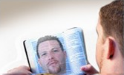
Seeing What We Are
New Person
We see what we truly are

Slide 12
Seeing What We Are
Conformed to His Image
New Person
We see
Ourselves
and LJC

Slide 13
Seeing What We Are
Cheerful Doer
Obedient Hearer
Law of Liberty
Delights in the Commands

Slide 14
Seeing What We Are
Legalism
Obedient Hearer
Obligation
Delights in the Commands

Slide 15
Seeing What We Are
I intensely desire to keep the Word of God because I…
“have to” -- Obligation
“get to” -- Liberty

Slide 16
Obligations versus Liberty
Reading/Studying the Bible
Prayer
Church Attendance
Giving
Cloths, Housing, Transportation

Slide 17
“Do not be deceived, God is not mocked; for whatever a man sows, that he will also reap. For he who sows to his flesh will of the flesh reap corruption, but he who sows to the Spirit will of the Spirit reap everlasting life.” (Gal 6:7-8)

Slide 18
Secret #4
Christian Living is Living with Our Hearts Open to God’s Truth

Slide 19

Living in the Light
The Light
Fellowship
Exposes Sin
Forgiveness
Confession

Slide 20

Living in the Light
The Light
Walk in Darkness
Fellowship
Repentance Necessary
No Exposure
Forgiveness
Denial of sin

Slide 21
Living in the Light
The Light
Prayer
Fellowship
Exposes Sin
Forgiveness
Confession

Slide 22
If We Ask
1 John 5:14-15

Slide 23
If We Ask
“Now this is the confidence that we have in Him, that if we ask anything according to His will, He hears us.

Slide 24
If We Ask
“And if we know that He hears us, whatever we ask, we know that we have the petitions that we have asked of Him.”

Slide 25
Me Prayer
“If we want something and we ask God for it in faith, believing it is His will, then we know He hears us, He is then obligated to give us what we want.”

Slide 26
If We Ask
Question
How can I know what is according to His will?

Slide 27

If We Ask
Answer

Slide 28
If We Ask
Context
God’s “commandments are not burdensome” (1 John 5:3a)

Slide 29
If We Ask
“And this commandment we have from Him: that he who loves God must love his brother also.” (4:21)

Slide 30
If We Ask
“Who is my brother?
“Whoever believes that Jesus is the Christ is born of God…” (5:1)

Slide 31
If We Ask
“How do we Know we’re loving our brother?
“when we love God and keep His commandments” (5:2)

Slide 32
If We Ask
“How do we know when “we love God”?
When we keep
“His commandments”

Slide 33
If We Ask
Is loving my brother hard?
John says, “It’s not hard to love your brother” for “His commandments are not burdensome.”

Slide 34
If We Ask
The Reason
“For whatever is born of God overcomes the world.” (5:4a)

Slide 35
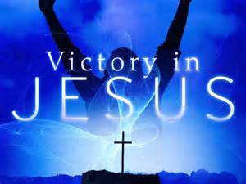
If We Ask
Faith
New Birth

Slide 36
If We Ask
“And this is the victory that has overcome the world -- our faith. Who is he who overcomes the world, but he who believes that Jesus is the Son of God?” (5:4a-5)

Slide 37
Two Aims
“These things I have written to you who believe in the name of the Son of God, that you may know that you have eternal life, and that you may continue to believe in the name of the Son of God.” (5:13)

Slide 38
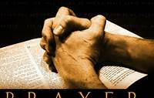
If We Ask
“The effectiveness of prayer depends on asking according to His will.

Slide 39
If We Ask
“Now this is the confidence that we have in Him, that if we ask anything according to His will, He hears us.” (5:14)

Slide 40
If We Ask
How do we do His will and keep His commandments?

Slide 41
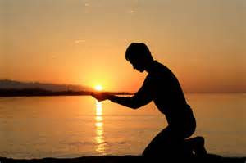
If We Ask
Praying for God’s Enablement

Slide 42
If We Ask
Faith
Continual Faith

Slide 43
If We Ask
The Light
Prayer
Fellowship
Exposes Sin
Forgiveness
Confession

Slide 44
Secret #5
Christian Living is an Answer to Prayer

Slide 45
Transformation Process
Continuous
Faith
Conform to His Image
Holy Spirit
Dead Body
Word of God
Prayer
Life

Slide 46
A Spiritual Mindset
Romans 8:5-6

Slide 47
A Spiritual Mindset
“For those who live according to the flesh set their minds on the things of the flesh, but those who live according to the Spirit, the things of the Spirit…

Slide 48
A Spiritual Mindset
“For to be carnally minded is death, but to be spiritually minded is life and peace.”

Slide 49
Wrong Way Thinking
If I just stop “living by the flesh”, then I can start “living by the Spirit”.

Slide 50
Right Way Thinking
You will stop “living by the flesh”, when you start “living by the Spirit”; by setting your mind on spiritual things.

Slide 51
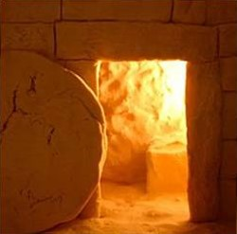
A Spiritual Mindset
Old Me
Died
New Me
Raised
Romans 6:3-4

Slide 52
A Spiritual Mindset
“reckon yourselves to be dead indeed to sin, but alive to God in Christ Jesus our Lord.” (Rom 6:11b)

Slide 53
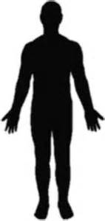

A Spiritual Mindset
New Person
“does not sin”
Holy Spirit

Slide 54
A Spiritual Mindset
“For to be carnally minded is death, but to be spiritually minded is life and peace.” (Rom 8:6)

Slide 55
Two Options
Carnally Minded
Spiritually Minded

Slide 56
Two Options
A Fleshly mind thinks a lot about sinful things. This is “the flesh’s way of thinking”.
Carnally Minded

Slide 57
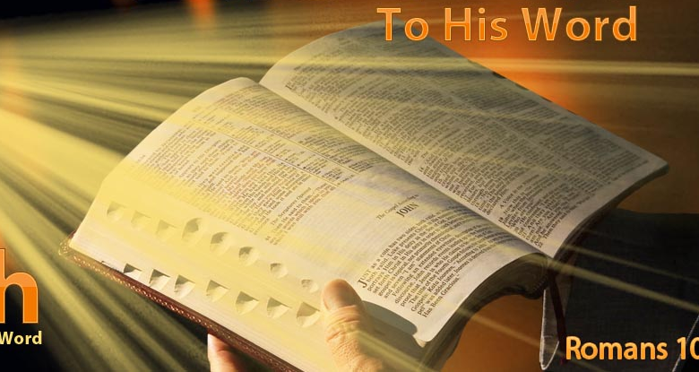
Two Options
Spiritually Minded

Slide 58
Two Options
Carnally Minded
Spiritually Minded

Slide 59
The Spiritual Mind
A spiritual mind thinks a lot about spiritual things. This is “the Spirit’s way of thinking”.
Spiritually Minded

Slide 60
The Spiritual Mind
“The Spirit’s way of thinking” is to think of Jesus Christ as our Savior and Lord.
Spiritually Minded

Slide 61
A Spiritual Mindset
“Or do you not know that as many of us as were baptized into Christ Jesus were baptized into His death?…

Slide 62
A Spiritual Mindset
“Therefore we were buried with Him through baptism into death, that just as Christ was raised from the dead by the glory of the Father, even so we also should walk in newness of life.” (Romans 6:3-4)

Slide 63
A Spiritual Mindset
“Therefore we were buried with Him through baptism into death, that just as Christ was raised from the dead by the glory of the Father, even so we also should walk in newness of life.” (Romans 6:3-4)

Slide 64
How It Actually Works
The Light
Holy Spirit
Spiritually Minded
Prayer

Slide 65
Secret #6
Christian Living is the Product of a Spiritual Mindset

Slide 66
Six Secrets
of the
Christian Life

